Slide 1
Mature Sons of the House:
Forsaking foolish, childish and worldly ways
Jere 4:22, Col 3:1-17
09/12/18

Slide 2
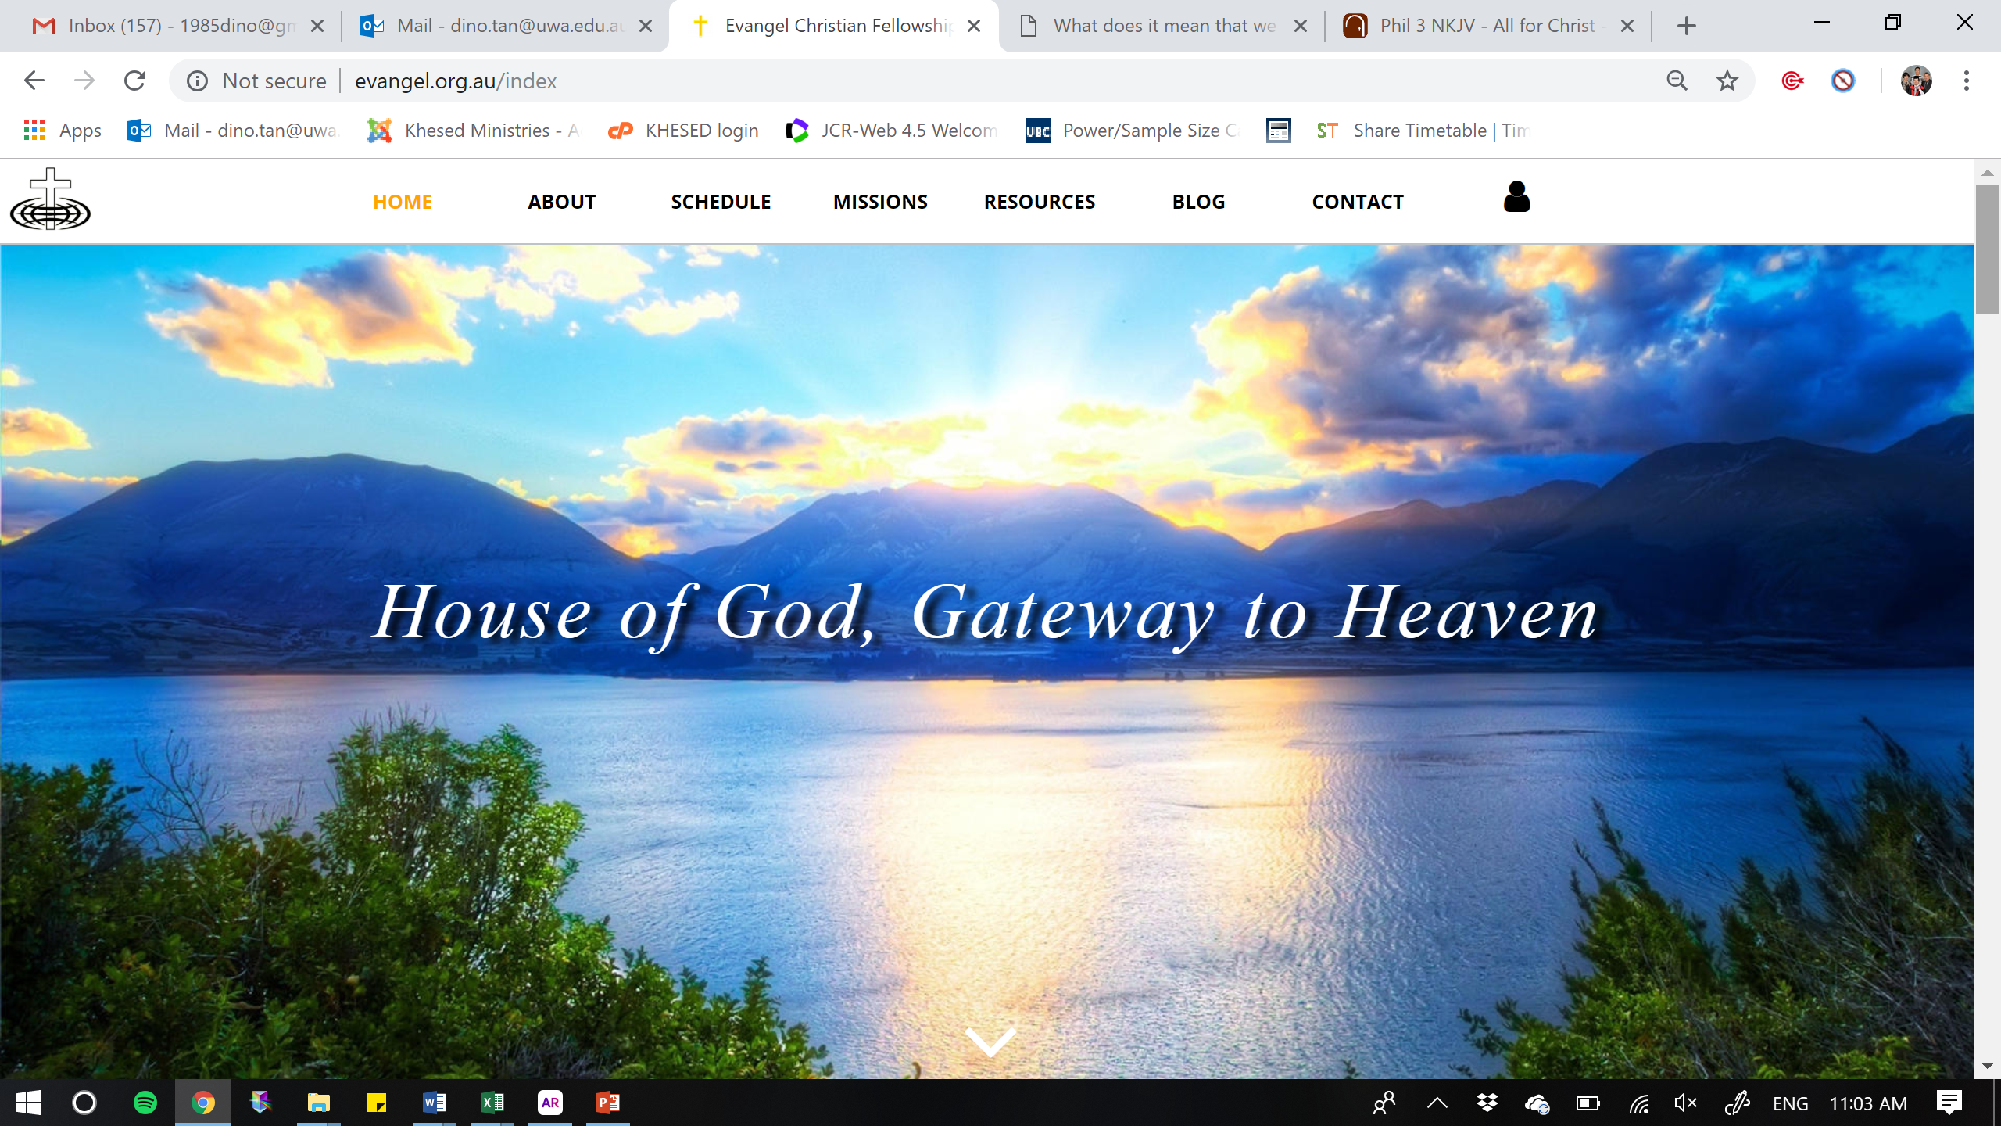
& from Heaven

Slide 3
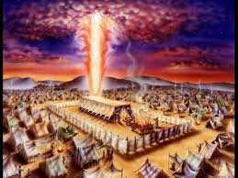
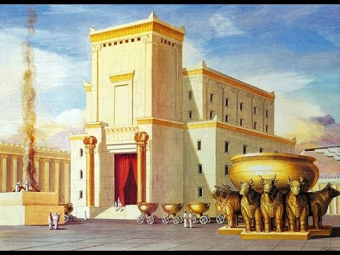
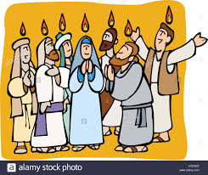


Slide 4

Theme 2018
STRATEGIC
Men & Women of Stature
POSITIONED
In Prophetic Precision
CREATING
Significant moves

Slide 5

RECAP: Setting order in God’s House
1. Jesus is Building His Church
You are the Christ,
The Son of the
Living God.
Matt 16:16-18

Slide 6

The House of God
1. Jesus is Building His Church
2. Jesus is Measuring His Church
What is God’s standard?
Worship
- In spirit & in truth?
(attitude)

Slide 7

The House of God
1. Jesus is Building His Church
2. Jesus is Measuring His Church
3. Jesus is Setting Order in His Church:
  Structure (The 5 Who’s; 1 Cor 12)
  Chain of authority
  Correction (Discipline; Heb 12:5-7)
  Hear and change
  Shaking (To prepare us; Heb 12:26-27)
  Religion, Pride, Idolatry

Slide 8
Jere 4:22
“For My people are foolish,
They have not known Me.
They are foolish children,
And they have no understanding.
They are wise to do evil,
But to do good they have no knowledge.”

Slide 9
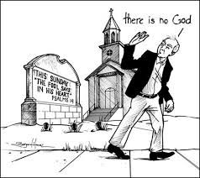
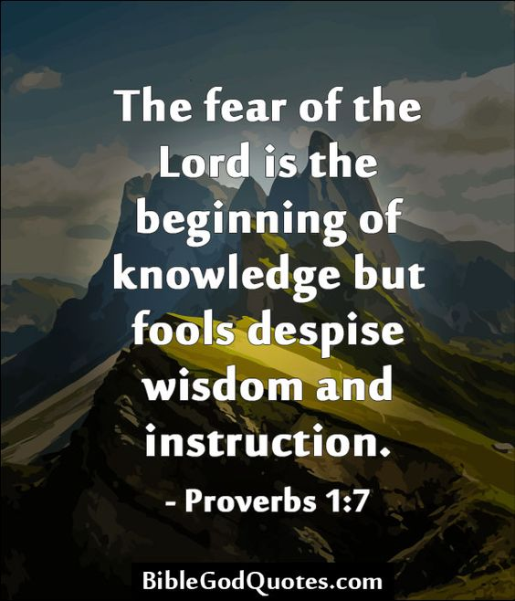
1) Forsake foolish ways
Does not know God

Slide 10
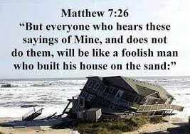
1) Forsake foolish ways
Does not do what he hears

Slide 11
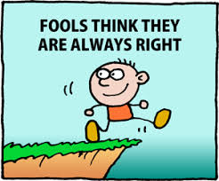
1) Forsake foolish ways
Prov 12:15 - The way of a fool
is right in his own eyes, But he who heeds counsel is wise.

Slide 12
HEAR & DO
HEAR & DO
FOUNDATION (ROCK) = JESUS CHRIST

Slide 13
Submitting to our appointed authority
Heb 13:17 - Obey those who rule over you, and be submissive, for they watch out for your souls, as those who must give account. Let them do so with joy and not with grief, for that would be unprofitable for you.
1 Pet 5:5 - Likewise you younger people, submit yourselves to your elders. Yes, all of you be submissive to one another, and be clothed with humility, for “God resists the proud, But gives grace to the humble.”

Slide 14
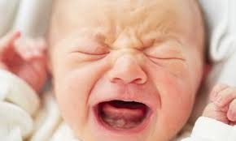
2) Forsake childish thoughts
Philippians 2:3-4 - “Do nothing from rivalry or conceit, but in humility count others more significant than yourselves. Let each of you look not only to his own interests, but also to the interests of others.”

Slide 15
2) Forsake childish thoughts
Spiritual babes = carnal-minded
1 Cor 3 - ¹And I, brethren, could not speak to you as to spiritual people but as to carnal, as to babes in Christ. ²I fed you with milk and not with solid food; for until now you were not able to receive it, and even now you are still not able; ³for you are still carnal. For where there are envy, strife, and divisions among you, are you not carnal and behaving like mere men? ⁴for when one says, “I am of Paul,” and another, “I am of Apollos,” are you not carnal?

Slide 16
2) Forsake childish thoughts
1 John 2:¹⁵ Do not love the world or the things in the world. If anyone loves the world, the love of the Father is not in him.
¹⁶ For all that is in the world
the lust of the flesh,
the lust of the eyes,
and the pride of life
is not of the Father but is of the world.

Slide 17
3) Forsake worldly things (Col 3)
Col 3:1-17

